Slide 1
REST in peace
Notes:
https://www.slideshare.net/AhmadHafizIsmail/introduction-to-graphql-or-how-i-learned-to-stop-worrying-about-rest-apis

Slide 2
Agenda
What is GraphQL
Schema
GraphQL Java
Mutations
Introspection
Tools
Demo

Slide 3
What is GraphQL
A query language for your API developed by Facebook….
….and a runtime for executing queries
With GraphQL, you model your business domain as a graph
GraphQL services typically respond using JSON, however does not require it.

Slide 4
GraphQL: who is using it… to name a few?

Slide 5
GraphQL: as a replacement for REST?
With REST you could achieve (almost) the same as with GraphQL
Some of the challenges when building RESTful APIs
Under/over-fetching of data
Multiple round trips when aggregating data
No real standards (REST=architectural style)
Naming things

Slide 6
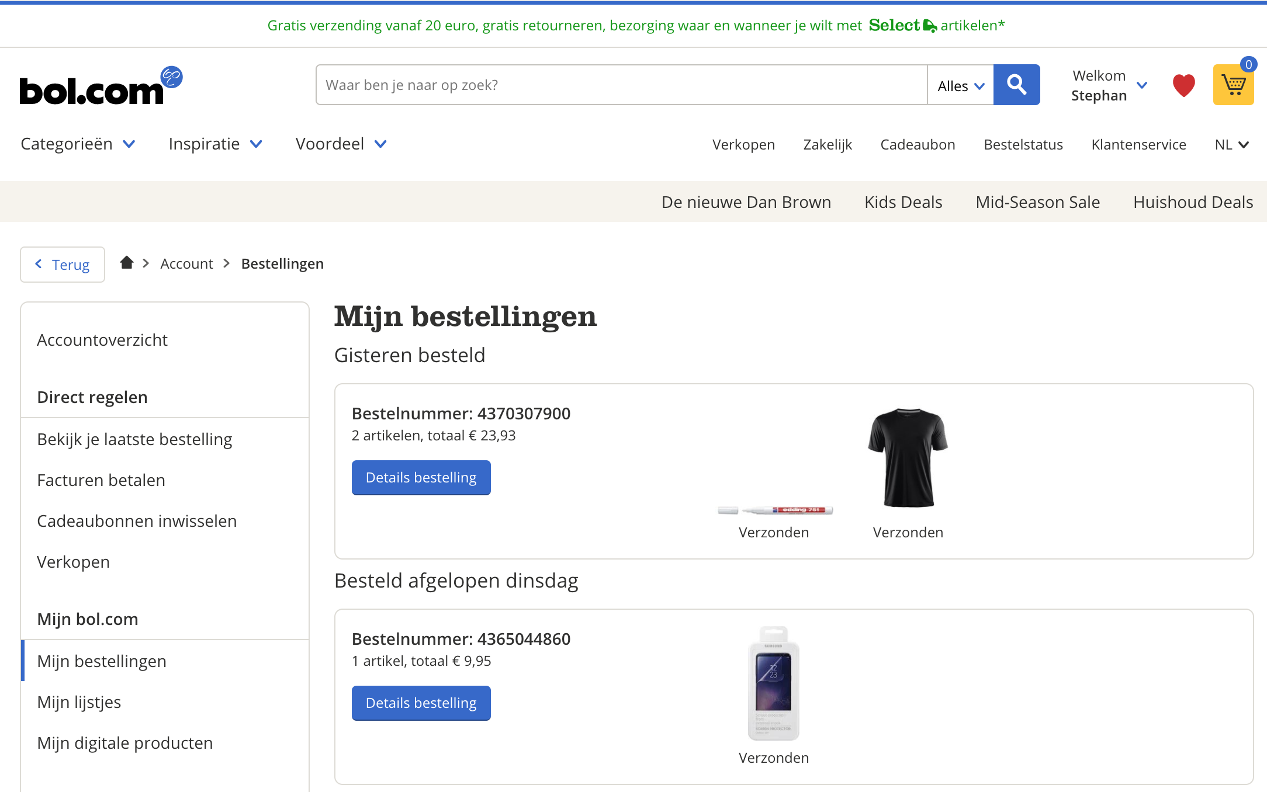
Consider this website…using REST (1)
GET /orders/4370307900
{ "totalPrice": "23.93",
// ... more fields }

Slide 7
Consider this website…using REST (2)
GET /orders/4370307900
GET /shipments/345
GET /shipments/345
GET /products/123
GET /products/234
Notes:
Multiple REST calls needed to get all the data on the screen.
From multiple different services

Slide 8
With REST we can solve this right?!
Expand parameter (leads to over-fetching)
GET /orders/4370307900?expand=product,shipment
…or…
Fields parameter (yay!)
GET /orders/4370307900?fields=totalPrice,orderItems(product(imageUrl),shipment(status))

Slide 9
But the problem with REST
No real standard for doing this (best-practices)
Lot of details you have to deal with as a developer!
How to do REST right anyway?

Slide 10
What if… GraphQL!
order (id: 4370307900) totalPrice orderItems product imageUrl shipment status

Slide 11
The same website…using GraphQL
Query
{ order (id: 4370307900) { totalPrice orderItems { product { imageUrl } shipment { status } } } }
Result
{ "data": { "order": { "totalPrice": "23.93", "orderItems": [ { "product": { "imageUrl": "https://123.img" }, "shipment": { "status": "verzonden" } }, { "product": { "imageUrl": "https://234.img" }, "shipment": { "status": "verzonden" } }] } } }

Slide 12
Agenda
What is GraphQL
Schema
GraphQL Java
Mutations
Introspection
Tools
Demo

Slide 13
GraphQL schema
You model your business domain as a graph
Different model implementation options
Schema-first: GraphQL SDL/IDL
Code-first approach
Hybrid: SPQR (speaker)
Notes:
http://graphql.org/learn/thinking-in-graphs/

Slide 14
GraphQL schema definition
Query (mandatory)
fetching data
Mutation (optional)
modifying data
Subscription (optional)
notifications
schema { query: Query mutation: Mutation
subscription: Subscription } type Query { … } type Mutation { … }
type Subscription { … }
Notes:
Two ROOT types:
Query
Mutation

Slide 15
GraphQL schema: types 1
Build in Scalar types:
Int: A signed 32‐bit integer.
Float: A signed double-precision floating-point value.
String: A UTF‐8 character sequence.
Boolean: true or false.
ID: The ID scalar type represents a unique identifier
type TypeName { fieldName: FieldType }
Notes:
Special build in types
List support
The term "scalar" comes from linear algebra, where it is used to differentiate a single number from a vector or matrix. The meaning in computing is similar. It distinguishes a single value like an integer or float from a data structure like an array.

Slide 16
GraphQL schema: types 2
type Order { totalPrice: String }
Build in Scalar types:
Int: A signed 32‐bit integer.
Float: A signed double-precision floating-point value.
String: A UTF‐8 character sequence.
Boolean: true or false.
ID: The ID scalar type represents a unique identifier.
Notes:
Special build in types

Slide 17
GraphQL schema: types 3
Other type options:
! mandatory fields or parameters
[] lists
And more build in types like interface, enum, etc.
Or custom Scalar types.
type Order { totalPrice: String!, orderItems: [OrderItem] }
Notes:
Special build in types

Slide 18
GraphQL schema: types 4
type Order { totalPrice(format: String!) : String }
Fields on a type can have arguments
can be marked mandatory with the ! sign
Notes:
Special build in types

Slide 19
GraphQL schema: model the shape of your data
type Order { totalPrice: String, orderItems: [OrderItem] }
type OrderItem { product: Product, shipment: Shipment }
type Product { imageUrl: String } type Shipment { status: String }
Notes:
Type
Fields
Fields are build in types
Or other types
Singular of plural []

Slide 20
GraphQL schema: Query type
query is a mandatory schema type
type Query is like any other type
With fields + arguments + type information
schema { query: Query }
type Query { order(id: Long!): Order }
type Order { totalPrice: String, orderItems: [OrderItem] }
Notes:
Special build in type
Field mapped to resolver (operation)
Fields can have arguments

Slide 21
GraphQL: Query (more later)
GraphQL Query is just a plain tekst string and looks like JSON without the fields
Query is enclosing in curly braces: { yourQueryHere }
type Query { order(id: Long!): Order }
type Order { totalPrice: String, orderItems: [OrderItem] }
{ order (id: 4370307900) { totalPrice orderItems { ...
} } }
Notes:
Special build in type
Field mapped to resolver (operation)
Fields can have arguments

Slide 22
Agenda
What is GraphQL
Schema
GraphQL Java
Mutations
Introspection
Tools
Demo

Slide 23
GraphQL: what do you implement
You develop a model, the GraphQL schema
You define a query, e.g. what shape of data do you need?
You execute it using the GraphQL runtime
You process the result

Slide 24
GraphQL runtime(s)
Runtime (server)
JavaScript Java C# / .NET Clojure Elixir Erlang Go Groovy PHP Python Scala Ruby
Client
C# / .NET Go Java / Android JavaScript Swift / Objective-C iOS

Slide 25
GraphQL Java, the players…
GraphQL Java
graphql-java: Java implementation and runtime for GraphQL
graphql-java-servlet: servlet endpoint for GraphQL
graphql-java-tools: library for schema-first GraphQL development
graphql-spring-boot: Spring boot starter for GraphQL
GraphQL SPQR
Code-first java library for Rapid GraphQL application development

Slide 26
GraphQL Java: developing the schema
Code first
Schema first
GraphQL Java
GraphQL Java Tools

Slide 27
GraphQL Java: code-first, builder style
val queryType = GraphQLObjectType.newObject() .name("Query") .field(GraphQLFieldDefinition.newFieldDefinition() .name("order") .argument(GraphQLArgument("id", Scalars.GraphQLLong)) .type(GraphQLObjectType.newObject() .name("Order") .field(GraphQLFieldDefinition.newFieldDefinition() .name("totalPrice") .type(Scalars.GraphQLString))).build()).build()
val schema: GraphQLSchema = GraphQLSchema.newSchema().query(queryType).build()
type Query { order(id: Long!): Order }
type Order { totalPrice: String }

Slide 28
GraphQL Java: code-first, reusable type
val orderType = GraphQLObjectType.newObject() .name("Order") .field(GraphQLFieldDefinition.newFieldDefinition() .name("totalPrice") .type(Scalars.GraphQLString)) val queryType = GraphQLObjectType.newObject() .name("Query") .field(GraphQLFieldDefinition.newFieldDefinition() .name("order") .argument(GraphQLArgument("id", Scalars.GraphQLLong)) .type(orderType).build() ).build()
val schema: GraphQLSchema = GraphQLSchema.newSchema().query(queryType).build()
type Query { order(id: Long!): Order }
type Order { totalPrice: String }

Slide 29
GraphQL Java: DataFetcher (field resolver)
Field data is fetched using a field resolver.
In graphql-java this is called a DataFetcher.
type Query { order(id: Long!): Order }
type Order { totalPrice: String }
class OrderDataFetcher : DataFetcher<Order> { override fun get(env: DataFetchingEnvironment): Order? { val id = env.arguments["id"] as Long return OrderRepository.getOrderById(id) } }

Slide 30
GraphQL Java: DataFetcher (field resolver)
val queryType = GraphQLObjectType.newObject() .name("Query") .field(GraphQLFieldDefinition.newFieldDefinition() .name("order") .argument(GraphQLArgument("id",GraphQLLong)) .type(orderType) .dataFetcher { env ->
OrderRepository.getOrderById(env.arguments["id"] as Long) } .build() ).build()
val schema = GraphQLSchema.newSchema().query(queryType).build()
type Query { order(id: Long!): Order }
type Order { totalPrice: String }
Notes:
DataFetcher fetches the backing data for a field type. Unless its provided by the current type.

Slide 31
GraphQL Java: developing the schema
Code first
Schema first
GraphQL Java
GraphQL Java Tools

Slide 32
GraphQL Java: schema-first
val schema = """ type Query { order(id: Long): Order
}
type Order { totalPrice: String } ""”
val typeDefinitionRegistry = SchemaParser().parse(schema)
val runtimeWiring = RuntimeWiring.newRuntimeWiring() .type("Query", { builder -> builder.dataFetcher("order", orderDataFetcher) }).build()
val graphQLSchema = SchemaGenerator() .makeExecutableSchema(typeDefinitionRegistry, runtimeWiring)

Slide 33
GraphQL Java: developing the schema
Code first
Schema first
GraphQL Java
GraphQL Java Tools

Slide 34
graphql-java-tools: schema-first
val schema = """ type Query { order(id: Long): Order
}
type Order { totalPrice: String } ""”
val graphQLSchema = SchemaParser.newParser() .schemaString(schema) .resolvers(object: GraphQLQueryResolver { fun order(id: Long) = OrderRepository.getOrderById(id) }) .build() .makeExecutableSchema()

Slide 35
GraphQL SPQR: code (only) first
Hybrid approach, generate schema from code (annotations)
object OrderService { @GraphQLQuery(name = "order") fun order(@GraphQLArgument(name = "id") id: Long) = OrderRepository.getOrderById(id) } val graphQLSchema = GraphQLSchemaGenerator() .withOperationsFromSingleton(OrderService) .generate()

Slide 36
GraphQL Java: defining a query
GraphQL Query is just a plain tekst string and looks like JSON without the fields
Query is enclosing in curly braces: { yourQueryHere }
Example:
{ order (id: 4370307900) { totalPrice } }

Slide 37
GraphQL Java: executing queries
You need a schema, create the GraphQL runtime and execute your query
val schema: GraphQLSchema = ...
val graphQL: GraphQL = GraphQL.newGraphQL(schema).build()
val executionResult: ExecutionResult = graphQL.execute("{ … }")

Slide 38
GraphQL: Execution Result
Consist of the following fields:
Data: containing the requested query data
Errors: available if any error occurred while executing the query
Extensions: meta info about the executed query

Slide 39
GraphQL: Execution Result
{ order (id: 4370307900) { totalPrice } }
{ "data": { "order": null }, "errors": [ { "message": "Exception message…”, "path": ["order"], "exception": { ... }, "extensions": null, "errorType": "DataFetchingException" } ] }

Slide 40
Agenda
What is GraphQL
Schema
GraphQL Java
Mutations
Introspection
Tools
Demo

Slide 41
GraphQL mutation: schema
Mutation is a build-in schema field, defines the mutation Type
schema { query: Query mutation: Mutation }
type Mutation { operation(argument: InputType): ReturnType }

Slide 42
GraphQL mutation: schema
Mutation example: create a new Order
type Mutation { createOrder(order: OrderInput): Order }
input OrderInput { totalPrice: String orderItems: [OrderItemInput] }
input OrderItemInput { productId: Long }

Slide 43
GraphQL mutation: query
Query that describes a modification
Starts with the mutation keyword (no curly braces)
Example:
mutation CreateOrder($order: Order!) { createOrder(order: $order) { id totalPrice } }

Slide 44
Agenda
What is GraphQL
Schema
GraphQL Java
Mutations
Introspection
Tools
Demo

Slide 45
GraphQL introspection: schema
Discover the schema information
{ __schema { queryType { name } } }
{ "data": { "__schema": { "queryType": { "name": "Query" } } } }

Slide 46
GraphQL introspection: type
Discover the type information
{ __type(name: "Query") { name fields { name args { name } } } }
{ "data": { "__type": { "name": "Query", "fields": [ { "name": "order", "args": [ { "name": "id" } ] } ] } } }

Slide 47
Agenda
What is GraphQL
Schema
GraphQL Java
Mutations
Introspection
Tools
Demo

Slide 48
GraphiQL
Demo

Slide 49
GraphQL Voyager
Demo

Slide 50
Agenda
What is GraphQL
Schema
GraphQL Java
Mutations
Introspection
Tools
Demo

Slide 51
Demo
GraphQL Spring Boot server in Kotlin

Slide 52
Aren`t there any problems?
Performance issue when exposing lots of aggregated data
Fetch depth and recursive model
Security not build in (easy to add OAUTH by passing headers)

Slide 53
Summary and conclusion
Formalized type system
Introspection build in
Very simple way of querying different shapes of data
Multiple implementation options
Very good for aggregation services (API gateway)
For simple (microservices) REST might be more straight-forward.

Slide 54
Links
http://graphql.org/learn/
https://www.howtographql.com/
https://github.com/graphql-java/awesome-graphql-java
https://developers.facebook.com/docs/graph-api/using-graph-api

Slide 55
Questions?

